Slide 1
Air Pollution Control
Hearing Board
Case No. 1377
NOV No. AQMV22-0016/0017
Metcalf Builders
Stonebrook Apartments
Sparks, Nevada
Joshua Restori, Supervisor AQMD
October 13, 2022

Slide 2
Topics of Discussion
Washoe County Health District Air Quality Management’s Authority and Purpose
Important Definitions and Concepts
Events of Case No. 1377
Notice of Violation No. AQMV22-0016
Notice of Violation No. AQMV22-0017

Slide 3
Washoe County Health District
Air Quality Management Division
Authority and Purpose

Slide 4
Washoe County Health District
Air Quality Management Division
The Washoe County District Board of Health Regulations Governing Air Quality Management 040.030 Dust Control
Purpose: To limit particulate material emissions into the ambient air from any property, operations or activities that may serve as a fugitive dust source. The effect of this regulation shall be to minimize the amount of PM10 emitted into the ambient air as a result of the impact of human activities by requiring measures to prevent, reduce or mitigate particulate matter emissions.
Notes:
The Air Quality Management Division is the delegated agency for determining compliance and enforcing the Washoe County District Board of Health Regulations Governing Air Quality Management.
040.030 is a SIP Approved rule for maintaining the National Ambient Air Quality Standards, which Washoe County was found to be in a “Nonattainment Status” in the late 80’s and early 90’s.
Critical tools in protecting the health and welfare of the public associated with particulate matter pollution.

Slide 5
Washoe County Health District
Air Quality Management Division
Permit Requirement No. 12 of APCP22-0121 associated with AQMV22-0016 states:
Visible dust may not be emitted into the air from any operations or disturbed areas of this project for more than 5 minutes in any hour period (Regulation 040.030, Section C. 1.)

Slide 6
Washoe County Health District
Air Quality Management Division
Permit Requirement No. 11 of APCP22-0121 associated with AQMV22-0017 states:
A log book of all dust control operations, containing all information as required by the Control Officer in the standard “WASHOE COUNTY DUST CONTROL LOG” must be maintained on a daily basis…
…The logbook shall be kept at the project site and made available to District representatives upon request.

Slide 7
Washoe County Health District
Air Quality Management Division
Permit Requirement No. 11 refers to the Compliance and Records requirement found in DBOH Regulations 040.030 Section E 2. a. (2) which states:
Any person who conducts dust generating activities subject to Section C.3 of this Rule shall maintain daily records demonstrating compliance with Section C of this Rule.
Daily records shall be made available to the Control Officer immediately upon request.
Notes:
Emphasize “Immediately” meaning the records are present onsite and kept up to date.
A site’s report card. Demonstrates that the site is cognizant of dust control at their site.
During the initial site inspection, the AQMD provided compliance assistance to the appellant by discussing the Dust Control Permit and the permit requirements.

Slide 8
Washoe County Health District
Air Quality Management Division
Important Definitions and Concepts

Slide 9
Washoe County Health District
Air Quality Management Division
Fugitive Dust
  The particulate matter, which is not collected by a capture system, which is entrained in the ambient air, and which is caused from human and/or natural activities, such as but not limited to, movement of soil, vehicles, equipment, blasting, and wind.

Slide 10
Washoe County Health District
Air Quality Management Division
Washoe County Dust Control Log
  The Dust Control Log serves as a tool for the permittee to stay in compliance with the DBOH Regulations and Dust Control Permit requirements.
  The Log communicates the permittees efforts in controlling fugitive dust from their project.

Slide 11
Washoe County Health District
Air Quality Management Division
Events of Case No. 1377

Slide 12
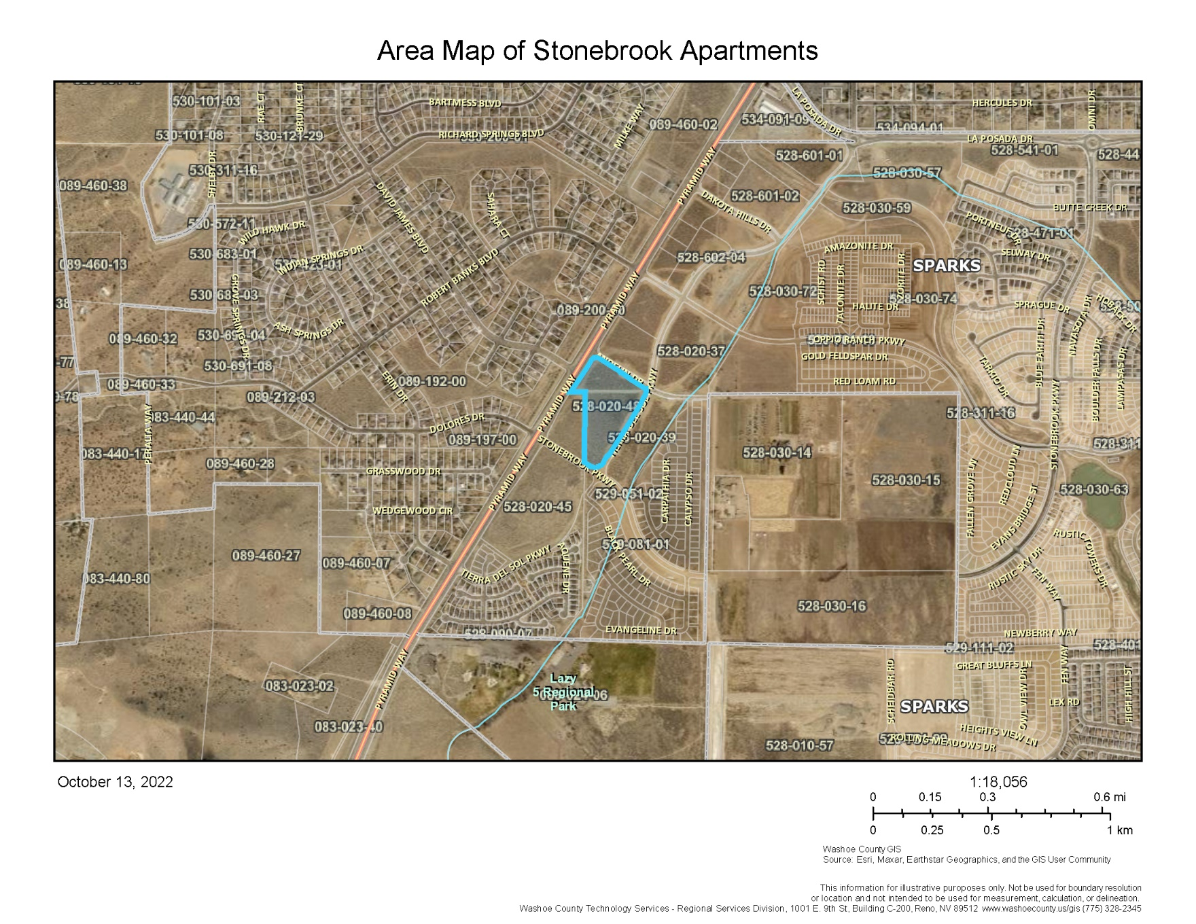
Notes:
1. Along Pyramid Highway; La Posada to the north; Lazy 5 Regional Park to the south.

Slide 13
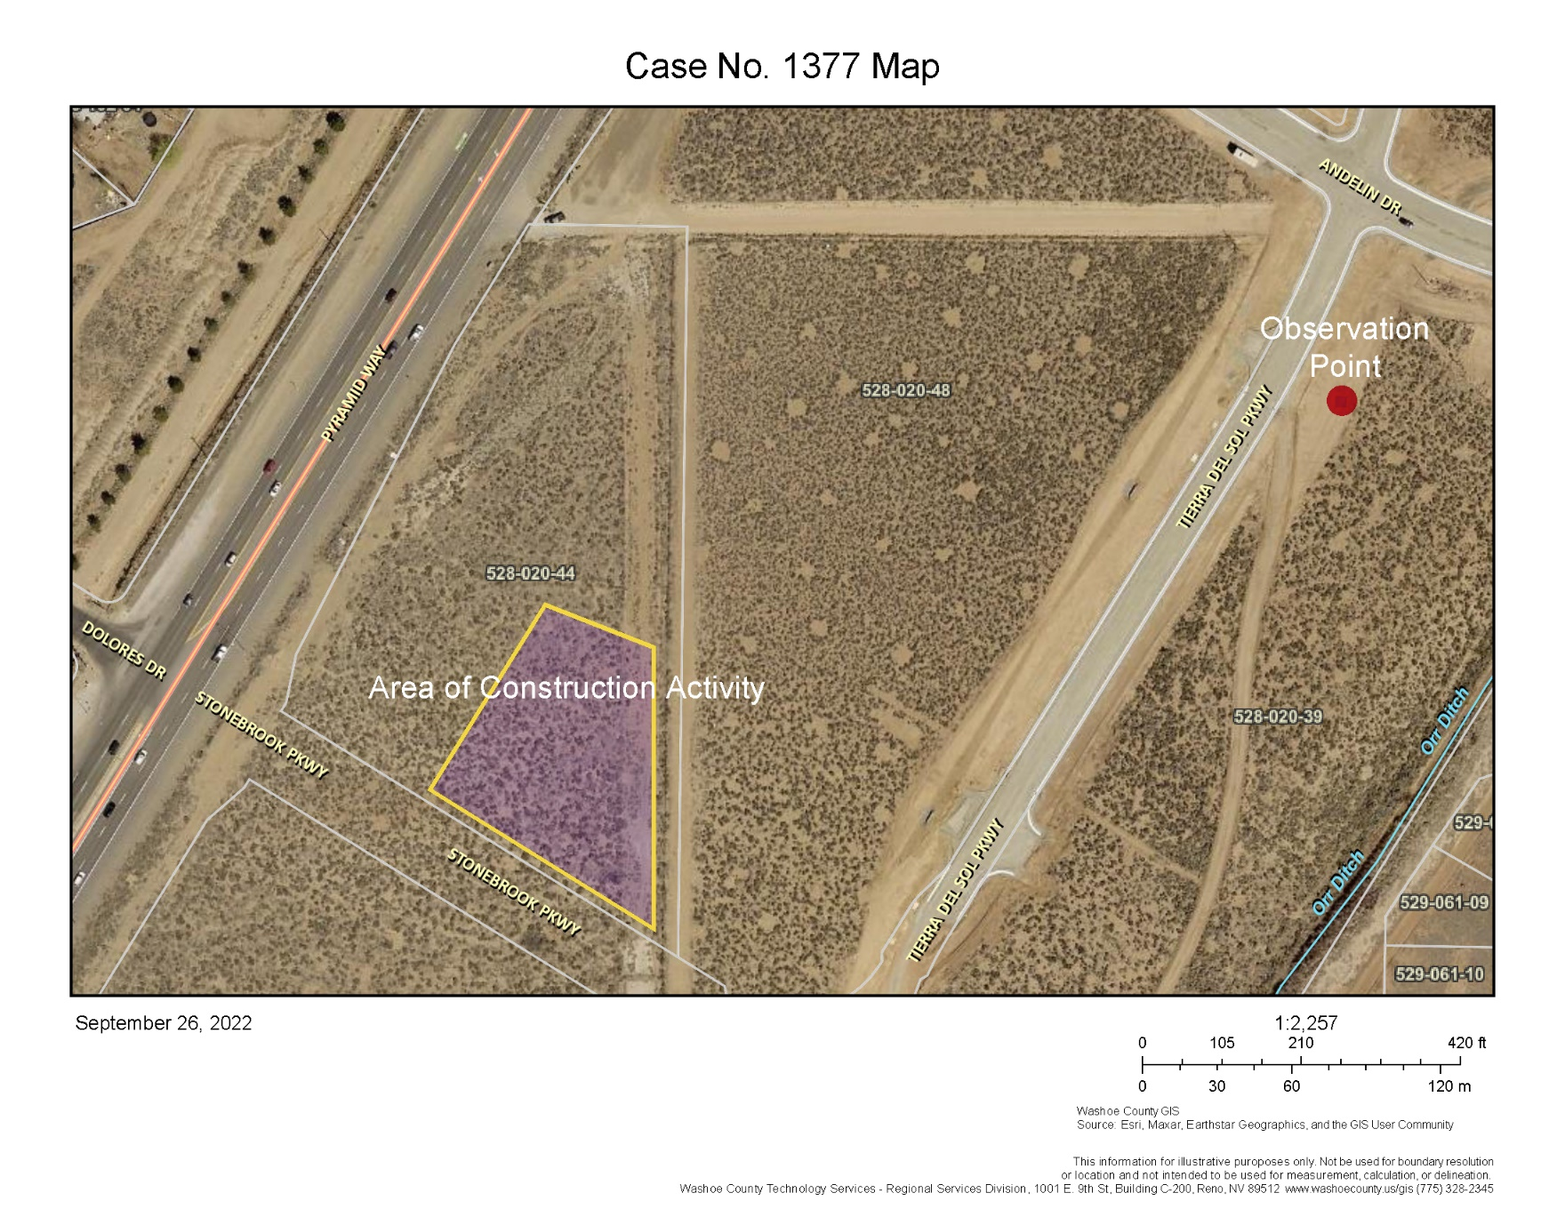

Slide 14
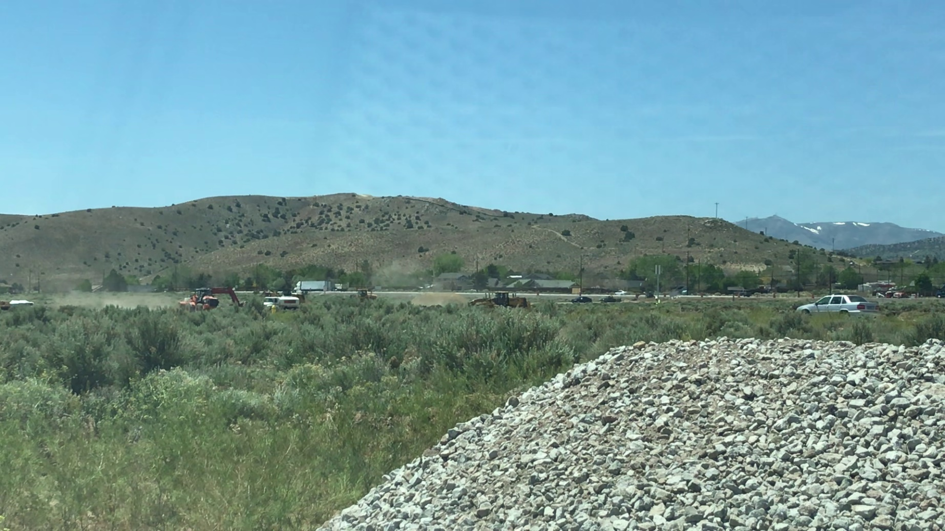
Washoe County Health District
Air Quality Management Division
Notes:
An air quality monitoring station is approximately a 3rd of a mile south of this project in the direction the fugitive dust is blowing.
Private residences exist approximately a 10th of a mile south of this project in the direction the fugitive dust is blowing. We want to emphasize these points as these rules are to protect public health and maintain the National Ambient Air Quality Standards based on data from our monitoring stations.

Slide 15
Washoe County Health District
Air Quality Management Division
May 18, 2022 – APCP22-0121 Stonebrook Apartments was issued to Metcalf Builders, Inc. for 20 acres
May 23, 2022 – The AQMD completed an inspection of the project due to dust concerns reported by a neighboring project; Equipment was shut down when the AQMD arrived and started a Method 22 evaluation for fugitive dust; Dust Control Permit Sign and Dust Control Logs were not present at the project; AQMD provided a verbal warning and discussed Permit requirements with appellant

Slide 16

Washoe County Health District
Air Quality Management Division
May 23, 2022 – AQMD received a dust complaint regarding the construction activity at Stonebrook Apartments

Slide 17
Washoe County Health District
Air Quality Management Division
May 24, 2022 – AQMD investigated the complaint and determined that there was no active dust mitigation while equipment was operating despite a water truck being onsite; The AQMD recorded in excess of (5) minutes of dust in a (1) hour period; The AQMD followed up with the appellant and asked to review the Dust Control Logs however the Logs were not present at the site

Slide 18
Washoe County Health District
Air Quality Management Division
Notice of Violation
No. AQMV22-0016

Slide 19
Washoe County Health District
Air Quality Management Division
Violation: Did the appellant control visible dust being emitted into the air from any operations or disturbed areas of this project to less than (5) minutes in any hour period pursuant to 040.030, Section C. 1. ? NO
Is this a violation of County and/or Federal Regulations? YES

Slide 20
Washoe County Health District
Air Quality Management Division
Notice of Violation
No. AQMV22-0017

Slide 21
Washoe County Health District
Air Quality Management Division
Violation: Did the appellant maintain their Dust Control Logs at the project site and provide them to the Control Officer immediately upon request pursuant to 040.080 Section E 2 a. (2) Recordingkeeping? NO
Is this a violation of County and/or Federal Regulations? YES
Notes:
1. The facts surrounding the case and presented this evening support the Air Pollution Control Hearing Board upholding the Notices of Violations and penalties.

Slide 22
Questions?

