Slide 1
Air Pollution Control
Hearing Board
Air Quality Management
Compliance Process
Francisco Vega, Director
October 13, 2022

Slide 2
Mission
The Air Quality Management Division (AQMD) implements clean air solutions that protect the quality of life for the citizens of Reno, Sparks, and Washoe County through community partnerships along with programs and services such as air monitoring, permitting, compliance, planning, and public education.

Slide 3
Air Quality Standards
The AQMD protects the air quality resource and the quality of life by ensuring compliance with the ambient air quality standards.

Slide 4
Air Quality Standards
Pollutant | Averaging Time | Level | Washoe County Design Value (2019)
Ozone | 8-hour | 0.070 ppm | 0.070 ppm
PM_{2.5} | 24-hour Annual | 35 mg/m³ 12 mg/m³ | 24 mg/m3 7.3 mg/m3
PM₁₀ | 24-hour | 150 mg/m³ | 0.0 expected exceedances
Carbon Monoxide | 8-hour 1-hour | 9 ppm 35 ppm | 1.6 ppm 2.2 ppm
Nitrogen Dioxide | 1-hour Annual | 100 ppb 53 ppb | 48 ppb 11 ppb
Sulfur Dioxide | 1-hour | 75 ppb | 4 ppb
Lead | 3-month | 0.15 mg/m³ | n/a

Slide 5
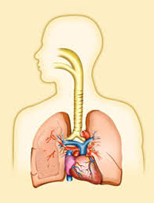
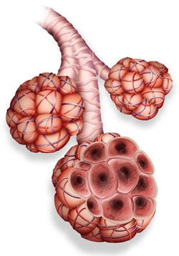
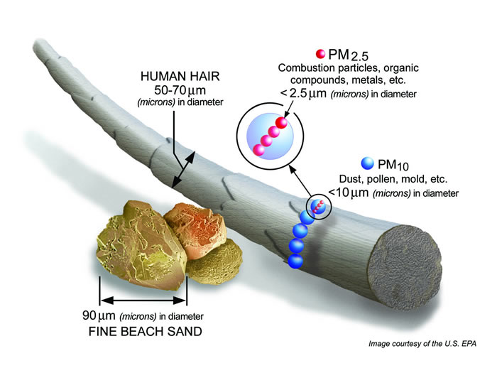
Health Effects of Air Pollution
Ozone
  Cough
  Throat Irritation
  Pain, burning, or discomfort in the chest when taking a deep breath
  Chest tightness, wheezing, or shortness of breath
Particulate Matter (PM)
  Coughing, wheezing, shortness of breath
  Aggravated asthma
  Lung damage (including decreased lung function and lifelong respiratory disease)

Slide 6
Air Quality Management Process
Monitoring Branch
Planning Branch
Permitting Branch
Compliance Branch
Notes:
Compliance Branch

Slide 7
Air Quality Management
Compliance and Enforcement Process
Notes:
Compliance Branch

Slide 8
Questions?

