Slide 1
Proposed WCHD Underground Storage Tank Permits & Fees
Contacts:
Wesley Rubio & Luke Franklin
775-328-2434

Slide 2
Program implemented in 1989
WCHD has performed routine UST inspections under the interlocal agreement with NDEP through October 2020
USTs
In
Washoe County

Slide 3
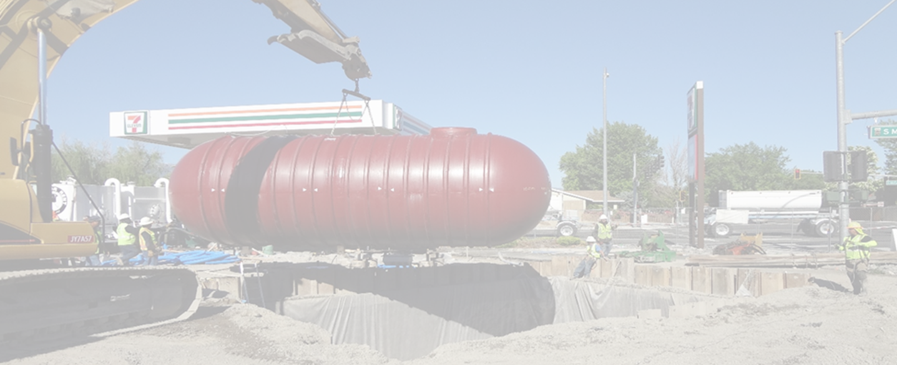
Why we are here
WCHD is working with NDEP
Re-establish WCHD as the regulatory authority for the Underground Storage Tank Program
UST Inspections, Release Determination, and continuation of Underground Storage Tank installation plan review, approval, and permitting through construction review.

Slide 4
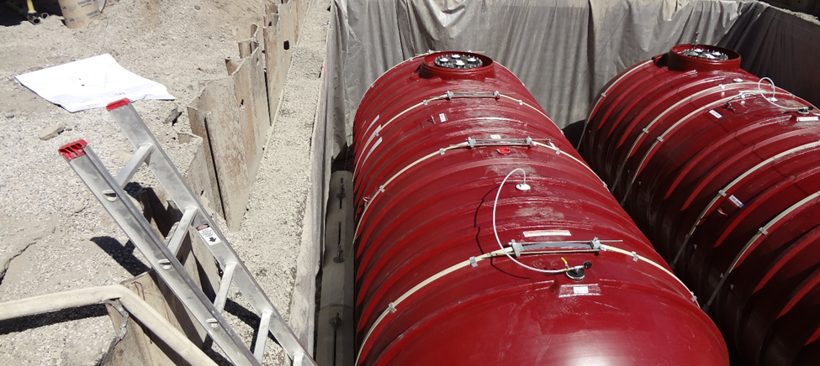
UST Inspections
Physical inspection of site, including opening all dispensers, fill ports, sump lids, controls, alarms, etc.

Slide 5
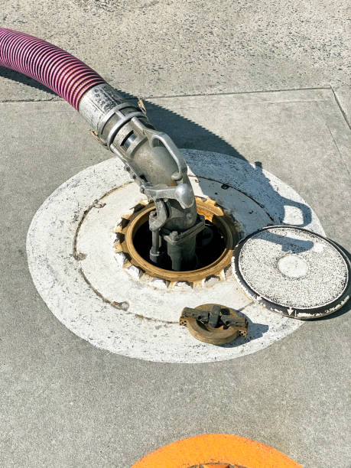
UST Insp
Record keeping review: required 30-day monitoring, annual testing, 3-year testing, proof of financial responsibility, staff training documentation, etc.
Report and Letter writing, re-inspection of deficiencies, submittal and review of missing documentation, onsite education, Federal and State UST requirements, discussion with operator and permit holder, issuance of NOVs, etc.

Slide 6
UST Installation

Slide 7
UST Piping Installation

Slide 8
UST Removal

Slide 9
UST Streamlined (Past to Proposed)
Prior UST program was staffed at 1.64 FTE’s
Proposed program staff is 1.1 FTE’s
Proposed will be a higher level of service
Physical Inspection every other year
Compliance follow-up every other year to ensure compliance with EPA and State of Nevada, NDEP
109 physical site inspections annually
109 compliance inspections annually

Slide 10
Proposed WCHD Permit Fee
February 27, 2014, the DBOH directed the WCHD that fees reflect the full cost of service provision, including a proportional share of infrastructure support
WCHD maintains interlocal agreement with NDEP at $100,000
Monies offset UST Program costs
$875.00 – Annual Permit Fees for:
underground storage tanks at fueling stations
underground tanks for emergency generators
underground tanks for waste oil

Slide 11
Implementation Plan
Should the DBOH approve the proposed permits and fees;
All facilities are notified after January 1, 2022
Permits and fees required no later than July 1, 2022
Provides 6 months of lead time to work with facilities to obtain appropriate operating permits with WCHD

