Slide 1
COVID-19
Reka Danko, M.D.
October 2021

Slide 2
What is COVID-19?
Virus is a type of Coronavirus
Specifically SARS-CoV-2 (Severe Acute Respiratory Syndrome Coronavirus 2)
Transmits from person to person by respiratory particles (coughing, sneezing, talking in close range to another person)
Infection also carries on hands and contaminated surfaces (for example door handles, keyboards, phones, steering wheels)
Transmission of infection begins prior to development of symptoms and some carry COVID-19 infection without symptoms
Virus invades a host (human) and then has to replicate and grow and cause illness or be stopped by the immune system
Most highly contagious in the time when virus is replicating and growing inside of the host
Viruses find a host in which to replicate – therefore virus may make variants for its own replication

Slide 3
Prevention of COVID -19
Distancing, avoiding crowds
Washing hands (using sanitizer) and wiping common touch surfaces which may be contaminated
Appropriate mask wearing
Avoid touching your face
Boosting natural immune system
Vaccination

Slide 4
Natural immunity after COVID-19 infection?
Antibodies develop in the body after exposure to viral infections to attack that virus if encountered again
Most patients develop antibodies to COVID-19, but the antibodies are variable – some do not develop antibodies and some develop small amounts of antibodies, antibodies are specific to the type of COVID-19 infection
Antibody levels may decline over time
Patients can become re-infected with COVID -19 after developing antibodies either due to declining antibody levels or due to virus variants

Slide 5
COVID-19 vaccines
Worldwide
23 different vaccines approved in at least 1 country
145 vaccines in trial (37 in phase I, 59 phase II, 49 phase III) and 8 no longer progressing
7 vaccinations approved by WHO
United States
Pfizer-BioNTech (Comirnaty)
Moderna
Johnson&Johnson also called Janssen

Slide 6
US Vaccines

Slide 7
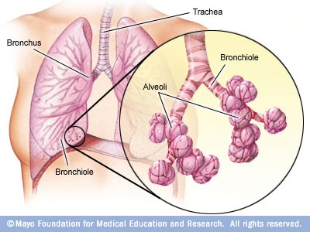
Lungs and breathing

Slide 8
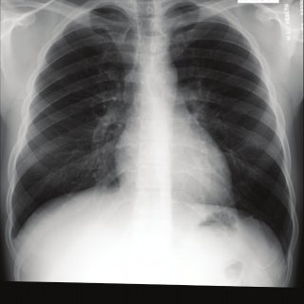
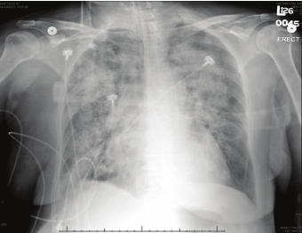
COVID in the lungs
Radiopaedia.org

Slide 9
Protecting yourself (before, during, and after COVID)
Keep immune system healthy
Exercise
Sleep
Healthy eating
Stay hydrated *important as some lose taste/smell with COVID infection
Reducing stress
Avoid smoking and vaping
Limit alcohol
Boost the immune system
Vitamins (Vitamin D, Vitamin C, Zinc)
Vaccinations (COVID, influenza, pneumonia if indicated)

Slide 10
Keep the lungs open
Avoid collapsing bases of the lungs
Lay on stomach or sides, preferred over laying on back
Move around to encourage deep breathing, walk at side of bed, intermittent deep breathing exercises and/or use an incentive spirometer to open the lung bases
Avoid smoking, vaping, and other harmful exposures in the lungs

Slide 11
Outpatient/Ambulatory Medications in treatment of COVID updated October 2021

Slide 12
Medications for hospitalized patients in treatment of COVID updated October 2021

Slide 13
Medications not recommended or for use only in clinical trials in treatment of COVID updated October 2021

Slide 14
Thank you
Reka Danko, MD
Board Certified, Internal Medicine and Addiction Medicine

